Slide 1
International Economics Tenth Edition
CHAPTER E I G H T
8
Trade Restrictions: Tariffs
Dominick Salvatore
John Wiley & Sons, Inc.

Slide 2
Learning Goals:
Describe the effects of a tariff on consumers and producers
Identify the costs and benefits of a tariff on a small and a large nation
Describe an optimum tariff and retaliation
Understand the meaning and importance of tariff structure

Slide 3
Introduction
While it is generally accepted that free trade maximizes world output and benefits all nations, most nations impose some restrictions on the free flow of international trade.
Trade policies are advocated by special groups that stand to benefit from trade restrictions.

Slide 4
Introduction
Import vs. export tariffs
An import tariff is a tax or duty levied on imported commodities.
This is the most common form of tariff.
An export tariff is a tax on exported commodities.
Prohibited by the U.S. Constitution, but occasionally practiced in developing countries to generate government revenue.

Slide 5
Introduction
Import vs. export tariffs
Ad valorem tariff
A fixed percentage on the value of the traded commodity.

Slide 6
Introduction
Import vs. export tariffs
Ad valorem tariff
Specific tariff
A fixed sum per physical unit of a traded commodity.

Slide 7
Introduction
Import vs. export tariffs
Ad valorem tariff
Specific tariff
A compound tariff
A combination of an ad valorem and specific tariff.

Slide 8
Introduction
Tariffs have been sharply reduced since World War II.
Tariffs average 5 percent or less on industrial products in developed nations, but are much higher in developing nations.

Slide 9
Partial Equilibrium Analysis of a Tariff
Resulting Effects of Tariff
Consumption effect
Reduction in domestic consumption
Production effect
Expansion of domestic production
Trade effect
Decline in imports
Revenue effect
Revenue collected by the government

Slide 10
Partial Equilibrium Analysis of a Tariff
Resulting Effects of Tariff
The more elastic the demand curve, the greater the consumption effect.
The more elastic the domestic supply curve, the greater the production effect.
The more elastic the demand and domestic supply curves, the greater the trade effect, and the smaller the revenue effect.

Slide 11
Partial Equilibrium Analysis of a Tariff
Resulting Effects of Tariff
Consumer surplus is the difference between what consumers would be willing to pay and what they actually pay.
Imposition of a tariff reduces consumer surplus.
Increase in producer surplus, or rent, is the payment that need not be made in the long run to induce domestic producers to supply additional goods with the tariff.
Also called subsidy effect of tariff.

Slide 12
Partial Equilibrium Analysis of a Tariff
Resulting Effects of Tariff
Tariff redistributes income -
From domestic consumers (who pay higher price for the commodity) to domestic producers (who receive the higher price)
From nation’s abundant factor (producing exports) to the scarce factor (producing imports).
This leads to inefficiencies, or protection costs (deadweight losses).

Slide 13
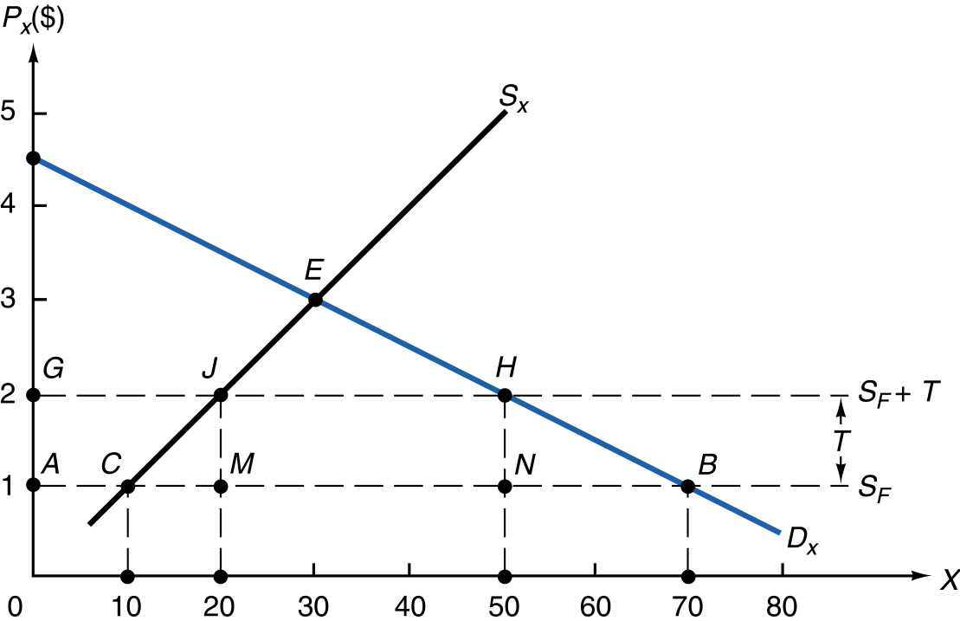
FIGURE 8-1 Partial Equilibrium Effects of a Tariff.

Slide 14
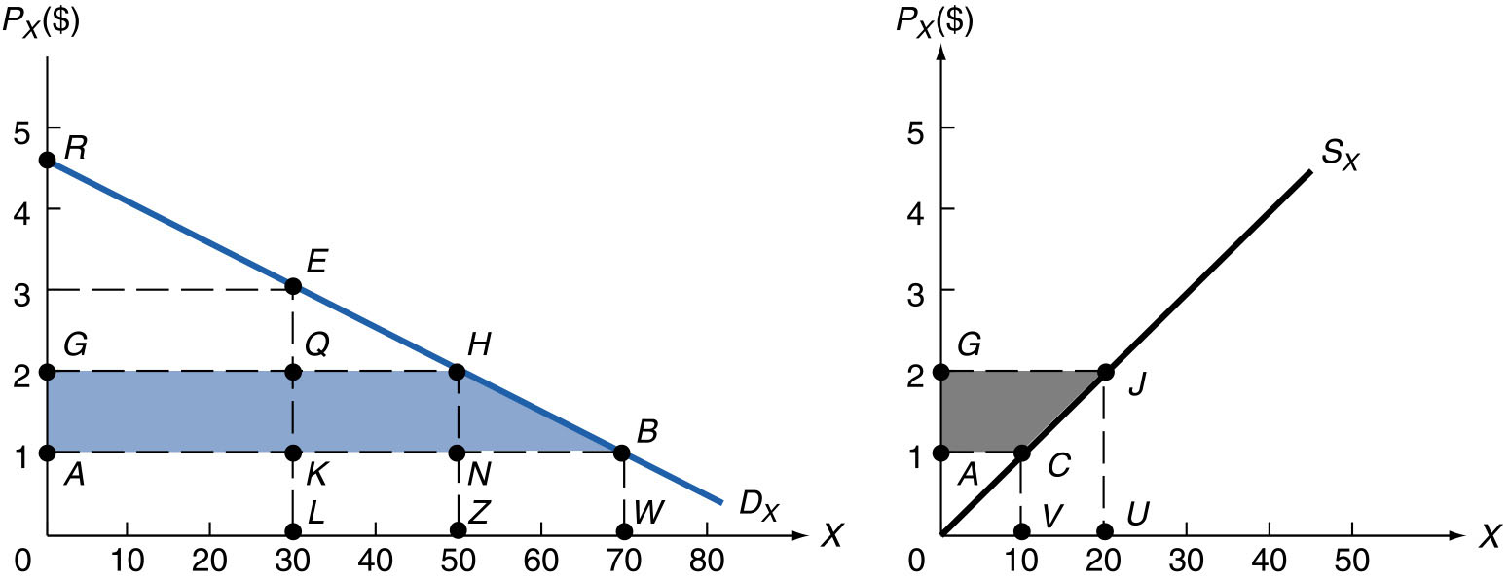
FIGURE 8-2 Effect of Tariff on Consumer and Producer Surplus.

Slide 15
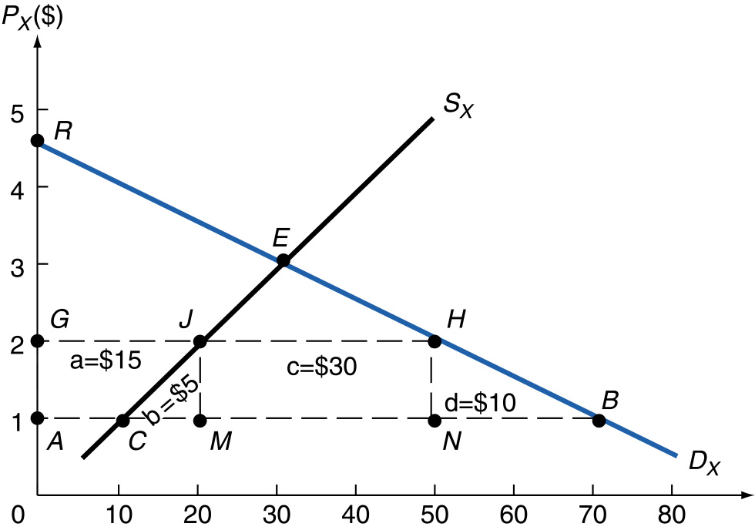
FIGURE 8-3 Partial Equilibrium Costs and Benefits of a Tariff.

Slide 16
The Theory of Tariff Structure
The Rate of Effective Protection
Indicates how much protection is actually provided to domestic producer of import-competing commodity.
When a nation imposes a lower tariff on imported inputs than on the final commodity produced with the inputs, the rate of effective protection exceeds the nominal tariff rate.

Slide 17
The Theory of Tariff Structure
The Rate of Effective Protection
Calculated as follows:
t - a_{i}t_{i}
g =
1 - a_{i}
g = rate of effective protection
t = nominal tariff rate on final commodity
a_{i} = ratio of cost of imported input to price of final commodity with no tariff
t_{i} = nominal tariff rate on imported input

Slide 18
The Theory of Tariff Structure
The Rate of Effective Protection
Calculated as follows:
t - a_{i}t_{i}
g =
1 - a_{i}
Conclusions
If a_{i} = 0, g = t
For given values of a_{i} and t_{i}, g is larger the greater is t
For given values of t and t_{i}, g is larger the greater is a_{i}
The value of g is >, = or < t, as t_{i} <, = or > t
When a_{i}t_{i} > t, the rate of effective protection is negative

Slide 19
General Equilibrium Analysis of a Tariff in a Small Country
A small nation will not affect prices on the world market when imposing a tariff.
Domestic price of importable commodity will rise by the full amount of the tariff for individual producers and consumers in the small nation.
Price remains constant for nation as a whole because the nation collects the tariff.
Volume of trade for small nation declines, but terms of trade do not change, so welfare always falls.

Slide 20
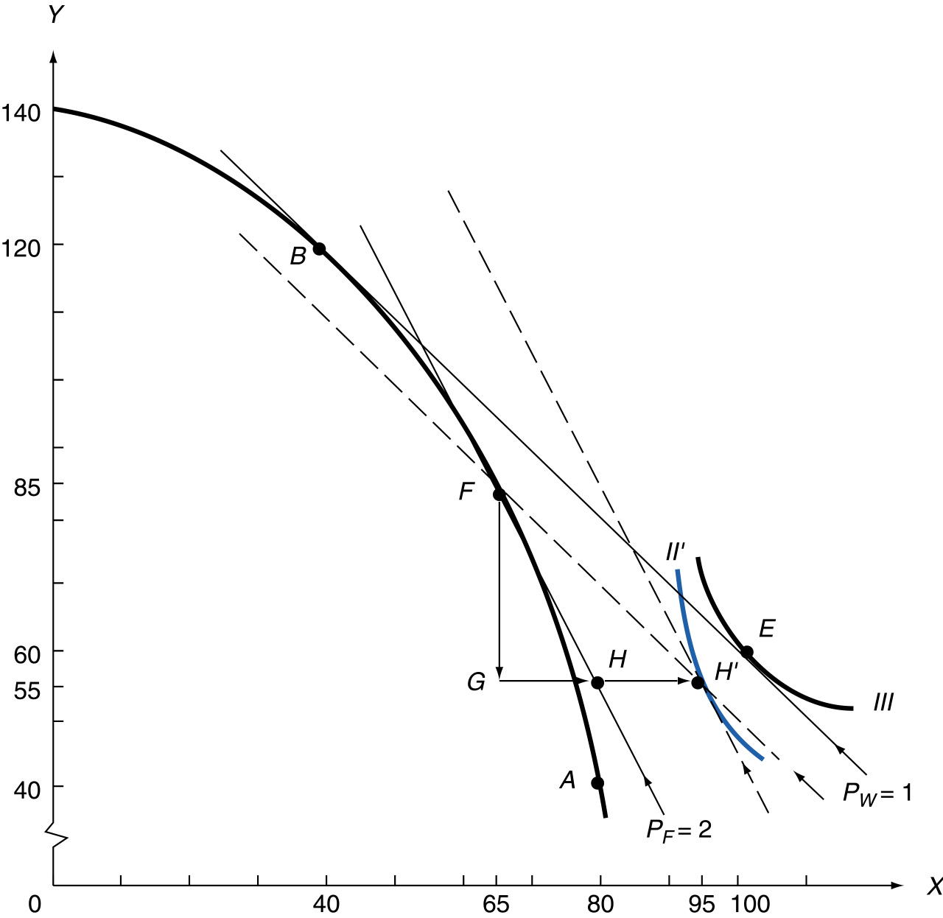
FIGURE 8-5 General Equilibrium Effects of a Tariff
in a Small Country.

Slide 21
General Equilibrium Analysis of a Tariff in a Small Country
Stolper-Samuelson Theorem
An increase in the relative price of a commodity (for example, as the result of a tariff) raises the return of the factor used intensively in production of the commodity.
Thus, the real return to the nation’s scarce factor of production will rise with the imposition of a tariff.

Slide 22
General Equilibrium Analysis of a Tariff in a Large Country
A tariff causes the imposing nation’s offer curve to shift or rotate toward the axis measuring the importable commodity by the amount of the tariff.
Under these circumstances, for a large nation:
A reduction in trade volume will reduce welfare
An improvement in terms of trade will increase welfare
Whether welfare actually rises or falls depends on net effect.

Slide 23
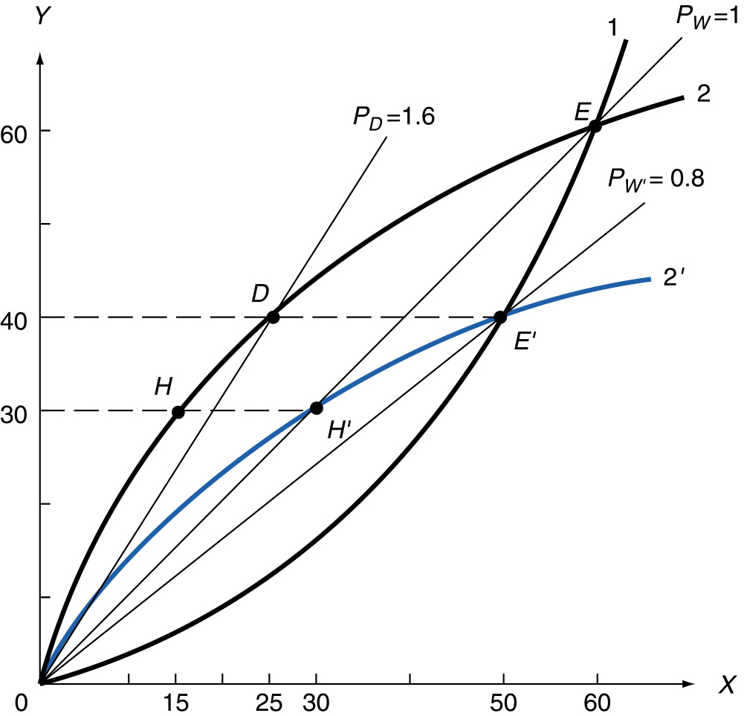
FIGURE 8-6 General Equilibrium Effects of a Tariff
in a Large Country.

Slide 24
The Optimum Tariff
An optimum tariff maximizes the net benefit resulting from the improvement in the nation’s terms of trade against the negative effect from declining trade volume.
As the terms of trade improve for the imposing nation, those of the trade partner deteriorate, reducing welfare for the trade partner.
Trade partner will likely retaliate and impose its own optimum tariffs.
World as a whole is made worse off as gains from optimum tariff are less than losses of trade partner.

Slide 25
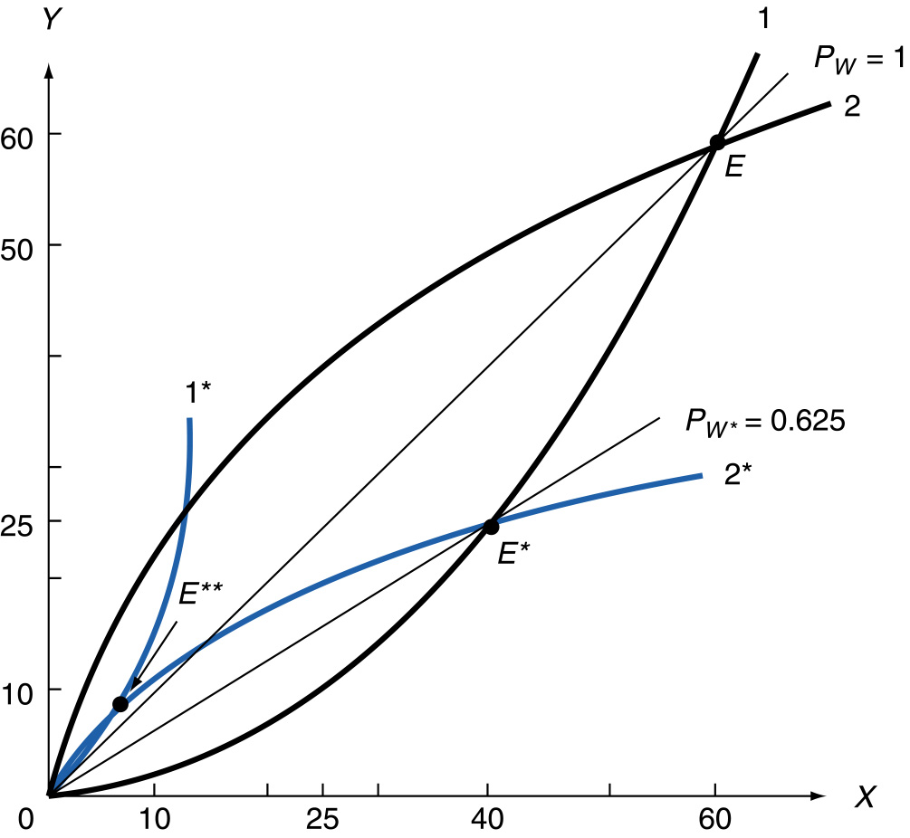
FIGURE 8-7 The Optimum Tariff and Retaliation.

Slide 26
Case Study 8-1 Average Tariff on Nonagricultural Products in Major Developed Countries

Slide 27
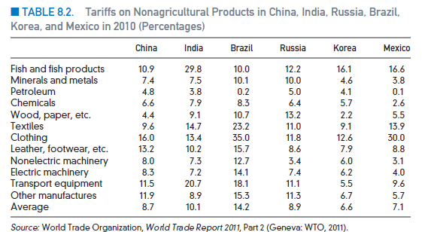
Case Study 8-2 Average Tariffs on Nonagricultural Products in Some Major Developing Countries

Slide 28
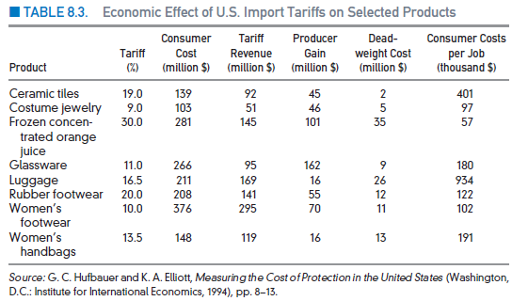
Case Study 8-3 The Welfare Effect of Liberalizing Trade on Some U.S. Products

Slide 29
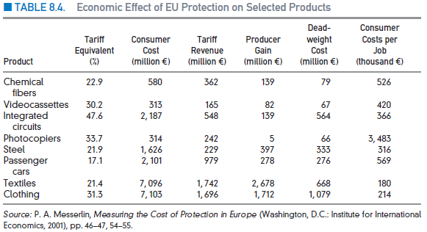
Case Study 8-4 The Welfare Effect of Liberalizing Trade on Some EU Products

Slide 30
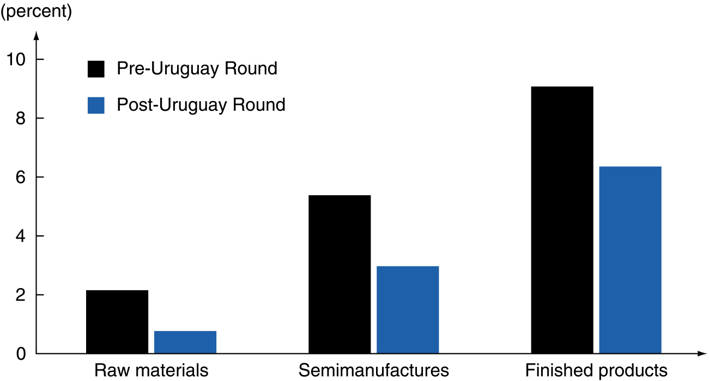
Case Study 8-5 Rising Tariff Rates with Degree of Domestic Processing
FIGURE 8-4 Pre- and Post-Uruguay Round Cascading Tariff Structure in Industrial Countries.

Slide 31
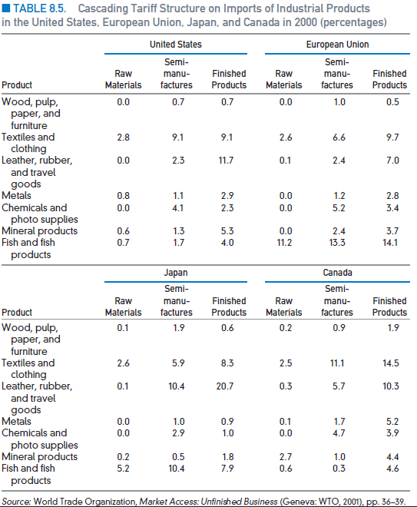
Case Study 8-6 Structure of Tariffs on Industrial Products in the United States, the European Union, Japan, and Canada

Slide 32
Appendix to Chapter 8
Partial Equilibrium Effects of a Tariff in a Large Nation
The Stolper-Samuelson Theorem Graphically
The Metzler Paradox
Short-Run Effect of Tariff on Factors’ Income
Measurement of the Optimum Tariff

Slide 33
(Figure continues on next slide)
FIGURE 8-8 Partial Equilibrium Effects of a Tariff
in a Large Nation.

Slide 34
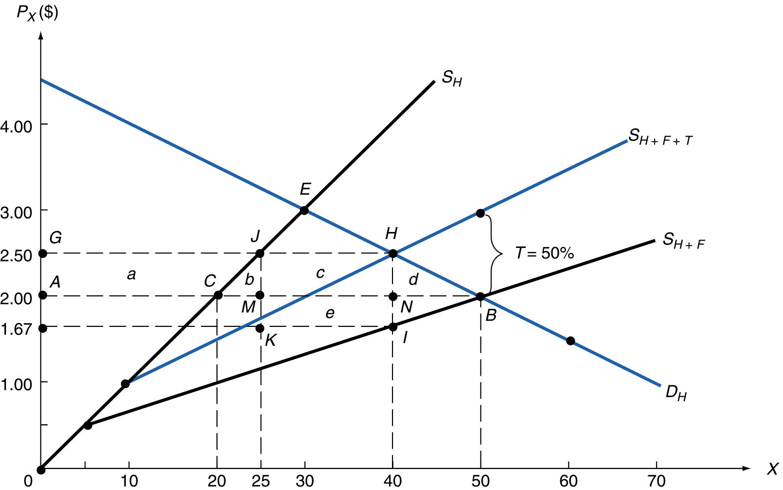
FIGURE 8-8 (continued)

Slide 35
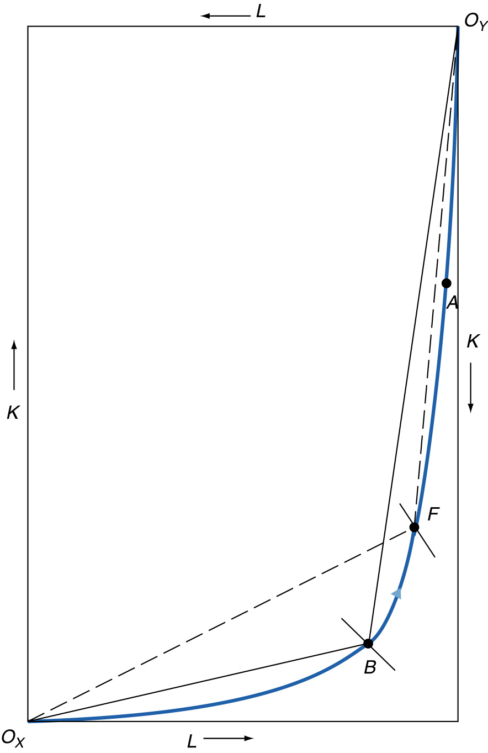
FIGURE 8-9 The Stolper-Samuelson Theorem Graphically.

Slide 36
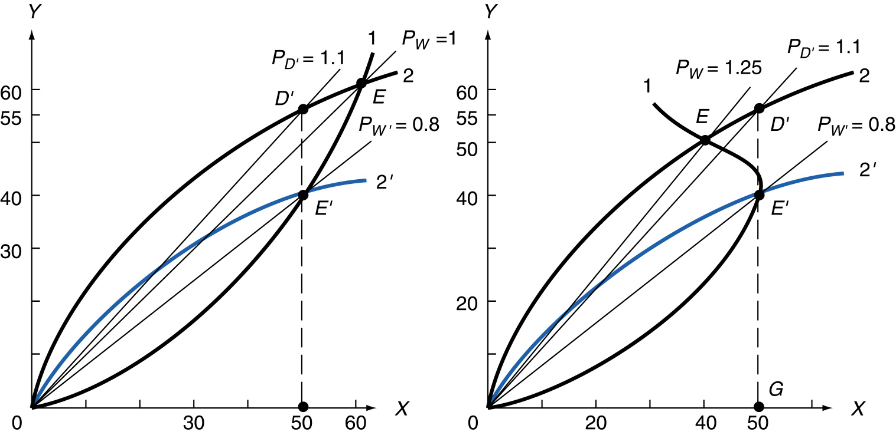
FIGURE 8-10 The Metzler Paradox.

Slide 37
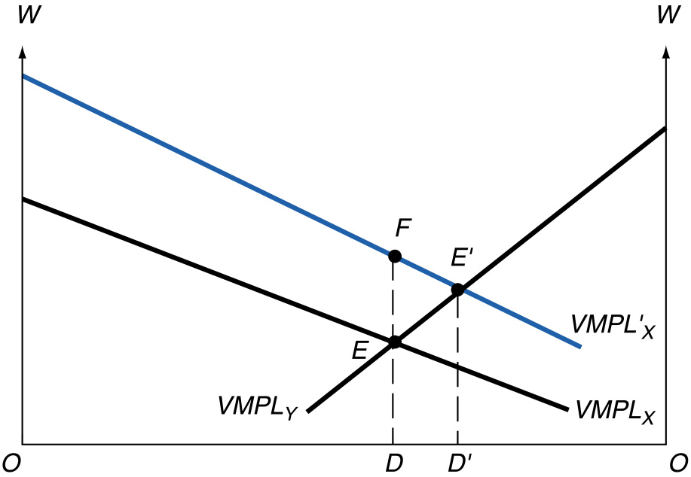
FIGURE 8-11 Short-Run Effect of Tariff on Factors’ Income.

Slide 38
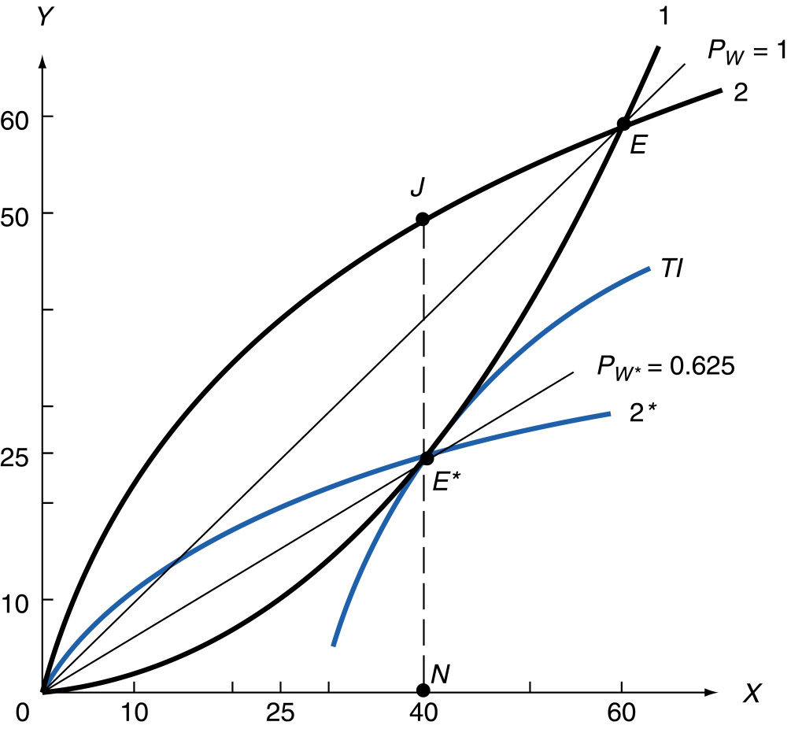
FIGURE 8-12 Measurement of the Optimum Tariff.

Slide 39
Copyright 2013 John Wiley & Sons, Inc.
All rights reserved. Reproduction or translation of this work beyond that permitted in section 117 of the 1976 United States Copyright Act without express permission of the copyright owner is unlawful. Request for further information should be addressed to the Permissions Department, John Wiley & Sons, Inc. The purchaser may make back-up copies for his/her own use only and not for distribution or resale. The Publisher assumes no responsibility for errors, omissions, or damages caused by the use of these programs or from the use of the information herein.
Notes:
Case studies and tables.

